Slide 1
Computer Graphics
Rendering

Slide 2
Subtopics
Images
Properties
Colors
Topologies
Rendering Pipeline
Overview
Main Stages
Overview of Stages
Input Assembler
Vertex Shader
Tessellation
Clipping
Rasterization
Pixel Shader
Output Manager
Setting the Pipeline Up
Requirements
Input Layout
Vertex Shader
Pixel Shader
Root Signature
Constant Buffers
Drawing
Steps

Slide 3

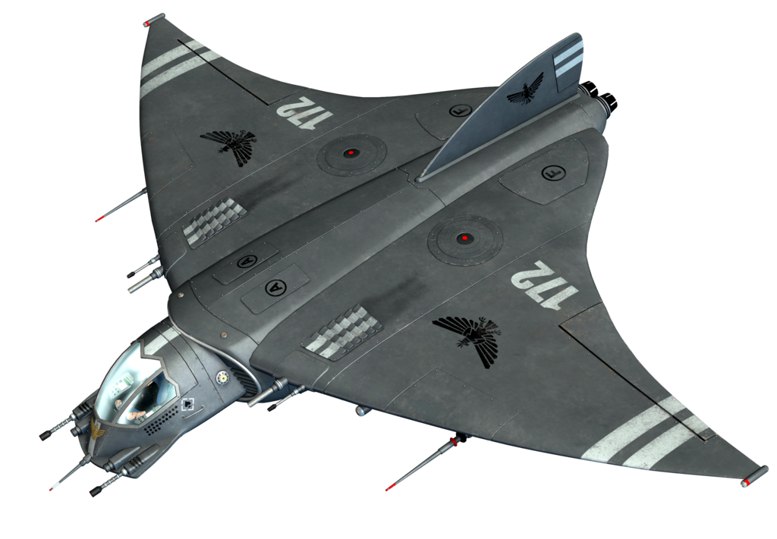


Images - Illusion
Making a two dimensional image to look three dimensional is a matter of combining different visual effects and techniques. Intuitively, we can list a few:
Lightning &
Reflections
Perspective
Shadows for height and light direction
Size, opacity & overlapping

Slide 4
Images - Colors
Pixels have colors. This are obtained by mixing Red, Green and Blue (RGA). Also, each pixel counts with an ALPHA value to determine its opacity. We can represent each pixel’s color as a 4D vector:
RGBA (R,G,B,A)
128-bit: each components ranges from 0 to 1, and counts with 4 32-bit floating point value.
32-bit: components are 8-bit integers (0-255) = 255³ = ~16 million possible colors per pixel.
We can convert back and forth by simply C₁₂₈* 255 = C₃₂ and vice versa.
Finally, to take advantage of SIMD (single instruction multiple data) 128-bit operations, we can use XMVECTOR to manipulate them. Also, DirectX provides in DirectXPackedVectors DirectX::PackedVector:XMCOLOR
Common operations we will do with colors are: addition, subtraction and modulation - all these are componentwise operations.
ALPHA
R
G
B

Slide 5
Images - Colors
As mentioned, XMVECTOR uses 128-bit to represent 4 components. On the other hand, XMCOLOR uses 4 unsigned integers of 8 bits each.
Most rendering operations, for example in shaders, use 128-bit XMVECTORs, while at the end of the day, the final buffer pixels will be represented as XMCOLORs. It is clear some precision can be lost in the translations, for this, DirectXMath provides store/load methods for the translation:
XMVECTOR PackedVector::XMLoadColor(XMCOLOR*)
PackedVector::XMStoreColor(XMCOLOR*,FXMVECTOR)

Slide 6
Images - Primitive Topologies
Fernando Geraci
The list of V < v₁, v₂ , … ,v_{k}> vertices we provide to the IA can represent:
Points List N points - no lines
Line Strip (N + 1) lines
Line List (N / 2) lines
Triangle Strip (N - 2) triangles
Triangle List (N / 3) triangles
Triangle List (N / 6) triangles
→ with Adjacent List (3 per triangle)
Adjacent vertices are not actually rendered. They are used for special purposes.

Slide 7
Rendering Pipeline - Overview
This is how the GPU’s rendering mechanism is called.
Geometric 3D Scene
and
Camera’s Descriptions
Each processing phase is called a “Stage”
A stage’s input could be in two ways:
Read a resource from GPU memory pool
Previous stage fed data
Some stages also write data back to the memory pool, for other stages to be able to use it further on.
We will proceed to formalize these stages.
Rendering stages
GPU’s VRAM
2D Image from the Camera’s Perspective

Slide 8
Rendering Pipeline - Stages
16 input slots
The stages are the following:
Input assembler (IA)
Vertex Shader (VS)
Hull Shader (HS)
Tessellation (TS)
Domain (DS)
Geometry (GS)
Stream Output (SO)
Rasterizer (RS)
Pixel Shader (PS)
Output Manager (OM)
IA
VS
HS
TS
DS
resources and buffers
GS
SO
RS
PS
OM

Slide 9
Rendering Pipeline - Input Assembler - Vertex Buffer
Input: A list (contiguous array) of v vertices and indices (Vertex buffer)
Output: Geometric primitive types: Lines and Triangles.
The vertices we provide, contain - among other things - spacial information. Vertices can have more information for advance uses. Before sending these to the pipeline, we need to indicate their type and the type of data they carry via Direct3D mechanics.
We need to tell D3D which primitive topology should follow for the provided input on every Draw() call
CommandList → IASetPrimitiveTolopology( D3D_PRIMITIVE_TOPOLOGY_* )
Direct3D reference

Slide 10
Rendering Pipeline - Input Assembler - Indices
We define an array of vertices as a simple array:
Vertices v = { v₁ v₂ v₃ … v_{k} }
The order in which we define (and feed) this vertices, is called the winding order and geometries will be processed in that order - order matters, big time.
Example:
v = { v₀ v₁ v₂
v₀ v₃ v₄
v₀ v₅ v₆
v₀ v₇ v₈ }
Bad!
Vertices structs take a lot of room
1
2
Note from the example, how all the triangles share the same center vertex. It would be inefficient to process it over and over for all four triangles. For this, we will create an INDEX LIST. This is an array of unsigned integers, which maps the <vertex,position>
Vertex Buffer = { v₀ , v₁ , v₂ , v₃ , v₄ , v₅ , v₆ , v₇ , v₈ } all unique values
UINT Indices = { 0, 1, 2, 0, 3, 4, 0, 5, 6, 0, 7, 8 } references to vertices
8
3
0
7
4
6
5
Duplicate indices are ok

Slide 11
Rendering Pipeline - Vertex Shader - Conversions
At this stage, every vertex we fed into the pipeline, can undergo by any transformation we might want to apply to them. This stage has access to the memory pool, so any resource or pre-loaded transformation matrix can be invoked to process vertices.
Here, he will take care of transforming all visible geometries into NDC (normalized device coordinates)
Local Space → World Space → View Space → Projection Space (Expressed in NDC)
While learning Transformations, we saw how models are made in local spaces, then placed in a common world space and then seen from a view space. We will discuss now depth of view using projection, which utilizes a frustum.

Slide 12
Rendering Pipeline - Tessellation Stage
This is an optional, but very powerful and fruitful stage. Tessellation let us triangulate triangles in the GPU. Here we will further split the original triangles we provided into more triangles, by dividing and subdividing them. This allows for:
Level of Detail: Tessellate triangles near the near-plane and don’t for the the ones closest to the far-plane.
Adding extra triangles while in the pipeline, allows for more room in memory, since we only have the original vertices.
Physics and animation processing can be done on low-poly meshes, the original vertex set, for then enriching with more triangles.
Hardware must be tessellation capable, and only Direct3D 11+ supports GPU tessellation. Before that feature level, this was done by the CPU.

Slide 13
Rendering Pipeline - Geometry Stage
Also optional, this stage will receive primitive geometries as input and, as opposed to the vertex shader stage, this one can create more or destroy some geometries to remove them from the pipeline based on specified conditions.
For example, this stage can get a line (primitive A) as input, and turn it into a quad:
This stage can stream data into memory for later stages to use.
New geometries must be transformed to homogeneous space.

Slide 14
Rendering Pipeline - Clipping
It is really important we never render anything that is beyond the boundaries of the frustum.
On the left, you can appreciate the 6 layers which will bound the rendering space:
Up, Down, Left, Right, Near and Far View
What about the geometries which are right on the boundaries of the frustum? We clip them and only render their visible parts.
The great news: The hardware takes care of clipping convex figures to each positive half plane and get rid of the parts on the negative sides.

Slide 15
Rendering Pipeline - Rasterization
VIewport Transform
Previously we computed the homogeneous clip space, now we will put the vertices in normalized device coordinates (NDC).
Backface Culling
The normal of a geometry is its orientation vector, from the middle of it. Given the set of vertices, we need to specify if the triangle is facing or not the viewer. A front-facing triangle, will have its vertices arranged in clockwise fashion, while back-facing, counterclockwise. When drawing, only front-facing (viable) triangles will be draw, based on their normal’s direction. We calculate them:
e₀ = v₁ - v₀
e₁ = v₂ - v₀
normal = (e₀ x e₁) / (e₀ x e₁) - front-face direction

Slide 16
Rendering Pipeline - Final Stages Overview
Pixel Shader
We will provide the GPU a program (shader) which is to be used to compute, based on interpolated vertices attributes values, a color for each pixel.
Output Manager
Finally the GPU will write the pixels onto the back buffer. We will see how in this stage we can “blend” the existing backbuffer pixels with the new ones, as opposed to override them, to create interesting effects.

Slide 17
Pipeline Configuration - Basic Setup
We saw how DIrect3D is initialized and all the basic components which need to be used for that purpose. Now we will proceed to set up the Pipeline. For this we will:
Configure the rendering pipeline
Describe our vertex structs
Create and bind Root Signature
Create and bind camera’s WorldViewProj matrix Constant Buffer
Create the Pipeline state’s description struct
Compile, load and add vertex and pixel shaders (Geometry shaders are optional)
Vertex Shader: will process EACH vertex position, color and attributes
Pixel Shader: takes the input from the previous shaders (Vertex/Geometry) and results in a color per pixel.
Now we can create geometries and bind buffers and indices
call Draw!

Slide 18
Pipeline Configuration - Configuring the Pipeline - Input Layouts
We need to describe our vertices. Direct3D allows to create our own struct to specify vertices attributes. Besides position, this can also include information such as normal, texture positions and color. We still need to let it know how our structures are shaped. We do this using a
D3D12_INPUT_LAYOUT_DESC struct
array of D3D12_INPUT_ELEMENT_DESC
A valid name (as any variable name) - POSITION, COLOR, NORMAL, TEX1 .. etc..
Parameters to specify type, struct offset and other attributes
number of elements (within the struct) we are describing
We will mainly start by creating two Vertex structs:
VertexA - position and color
VertexB - position, normal, texture coordinates 1 and texture coordinates 2

Slide 19
Pipeline Configuration - Configuring the Pipeline - Vertex Buffers
Once we have created and described our vertices, we will create the buffers we will use to push vertices into the pipeline. We will use a ID3D12Resource (1-dimensional and plain) to describe a buffer.
We will use the wrapper class CD3D12_RESOURCE_DESC to create the buffers. This one just provides convenient ::Tex<1D,2D,3D> methods for plain buffers.
For static vertices (objects which do not change per-frame) we will use the default heap - fastest, still we have a problem. For initializing the vertex buffer, the CPU will have to write to it, and because the CPU has no access to the default heap, we will need a “before-initialization” buffer to pass it to the default heap.
Resources will go into memory, which is the GPU’s HEAP. There are 4 types of HEAPS:
Default (no CPU read/write), Upload (CPU write), ReadBack (CPU read/write) and Custom
Each of this defined how the GPU and CPU can read/write to buffers.
Reference
UPLOAD
HEAP
DEFAULT
HEAP
CPU

Slide 20
Pipeline Configuration – Vertex/Pixel Shader
The shader access our Vertex struct members by using the SEMANTIC name defined in the Input Layout Element Description. Also, we could defined shader-internal structs to describe our vertices (input) and the result (output vertex).
Shaders syntax include float4x4, float4 etc… to describe matrices and vectors. Built-in functions such as mul(), and many other resources - HLSL reference..
Shaders can have preloaded matrices and values stored in the GPU’s memory (buffers). For example, the View Transform matrix.
The main function of the Vertex Shader is to, for each vertex, do some processing to prepare it for the Geometry or Pixel.
Shader stages. For starters, if no Geometry Shader is defined, we MUST return the position in homogeneous clip space.
We do NOT do the perspective divide to put it on NDC - this is done by the hardware.

Slide 21
Pipeline Configuration – Memory
During rendering, the pipeline stages, as we mentioned, will have access to the GPU’s VRAM to access resources such as matrices, textures and other resources.
The regions of memory that will be used, are buffers which will defined by something called a Root Signature.
This Root Signature, is just that! The signature of some sort of method, on which we pass parameters of a given type!
We will start by defining what constant buffers are for then explaining which role they play in the root signature of the pipeline.
Once the signature has been set, we can change, on each draw call, the values of the parameters we will bind for that call. Bare with me.

Slide 22
Pipeline Configuration - Constant Buffers
Shaders have access to buffers which might need to get updated every frame. This, clearly will need to be in the UPLOAD heap, since the CPU will periodically write to them.
We will place the WorldViewProject matrix in a constant buffer for the shaders to use, and within each Shader, we will register it:
cbuffer cbPerObject : register(b0) {
float4x4 gWorldViewProj; // this cbuffer will carry the updated matrix
}
Note that this buffer must be a multiple of the minimum hardware allocation size, which is 256 bytes. We do this when creating the buffer in the UPLOAD heap.
bytes = ceil((sizeof(object) * numberOfObjects) / 256) * 256
bitwise way (alternative): (bytes + 255) & ~255; // negate the first two bits to round it up

Slide 23
Pipeline Configuration - Constant Buffers
Finally, constant buffers need to be bound to the pipeline via descriptors, which are stores, just as the Depth/Stencil and Backbuffers (Render Target Views) ones, within heaps.
IMPORTANT
When stuffing the D3D12_DESCRIPTOR_HEAP_DESC , the flag must allow shaders to be able to see this buffers, so we must use:
D3D12_DESCRIPTOR_HEAP_FLAG_SHADER_VISIBLE

Slide 24
Pipeline Configuration - Registering Pipeline Resources
Shaders will be able to access resources from, among other types, constant buffers.
cbuffer cbPerObject : register(b0) {
float4x4 gWorldViewProj;
}
Within the shader programs, we will use the resources we put in memory, the shader can then access them via registered slots. This is know as Root Signature .
b0
Root Parameters₁
Descriptors Table
b1
b2
Root Signature
Root Parameters₂
Root Constant
...
...
Root Descriptor
Root Parameters_{k}

Slide 25
Pipeline Configuration - Registering Pipeline Resources
To create a Root Signature, we will:
Create the Root Parameters array
Create the Descriptor Range (Table/s) - could be an array, or simply 1
Bind the Root Parameter and the Descriptor Range
Create a Root Signature descriptor and bind the parameters to it
Create the Root Signature
Root Signature
Root Parameter
Descriptors Table
Commands Queue
CBV
Constant Buffer Heap

Slide 26
Pipeline Configuration - Shaders
Shaders are programs written in .hsls extension files. HLSL stands for High Level Shader Language.
These are compiled into portable (HW independant) bytecode by either our application - during runtime, using D3D - or offline using FXC. The most common method is to be compiled in Visual Studio when building our App (before runtime) This allows us to deal with compile programs and improve runtime.
A single Shader file can contain many ‘sub-programs’ represented as functions, this is not possible if we are not using FXC via command line. Visual Studio only takes a single program per shade (HSL) file.
The compiled code is turned into a .CSO file, which is loaded as bytes during runtime and passed into the pipeline for this to use to process vertices, pixels or other functions.
We need to specify the input function. This will have parameters which serve as input OR output. Once a vertex is processed, it is ready for the next stage of the pipeline.
During runtime, we can compile and load the bytecode using D3D12CompileFromFile - or simply loaded into a D3D12Blob (stream of bytes) from the previously offline-compiled file.

Slide 27
Pipeline Configuration - Vertex Shader
When pushing vertices into the Vertex Shader, this expects that the structure has AT LEAST everything that was described in the Input Layout.
CPP file:
struct Vertex {
XMFLOAT4 col;
XMFLOAT3 pos;
}
D3D12_INPUT_ELEMENT_DESC:
{ "POSITION",0,DXGI_FORMAT_R32G32B32_FLOAT,0,0, D3D12_INPUT_CLASSIFICATION_PER_VERTEX_DATA,0}
{ "COLOR",0,DXGI_FORMAT_R32G32B32A32_FLOAT,0,12, D3D12_INPUT_CLASSIFICATION_PER_VERTEX_DATA ,0 }
Vertex Shader file:
struct VertexIn {
float3 iPos : POSITION;
float4 iCol : COLOR;
}
The vertex will leave in homogeneous clip space to the Pixel Shader
The cbuffer sections refer to a constant buffer (coming up)

Slide 28
Pipeline Configuration - Pixel Shader
Once here, the Pixel Shader will work just as the Vertex one, but instead of working with vertices, it will work with each pixel of the projected image on the homogeneous space. Note that some pixels might have been rejected by the hardware (depth test) in early stages except that we specify not to.
The input of the shader will be the output of the vertices from the Vertex/Geometry (if available) shaders.
Each pixel, will leave with a processed color from this shader.
Example:
float4 main(VertexOut pIn) : SV_TARGET {
return pIn.oColor;
};
This example, simply returns the same color which had the vertex passed by the previous shader.

Slide 29
Pipeline Configuration - Setting the Pipeline’s State
We will proceed to describe the pipeline, this includes:
Root Signature - Pointer to the
Shaders (vertex, pixel, geometry, domain and hull shaders) - Compiled bytecode pointers
Stream Output - Set to default (0)
Blend State - Set to default
Rasterizer - Backface culling and order policy
Depth/Stencil State - Set to default
Input Layout - Elements descriptions
Primitive Topology - Type of primitive to use
Rtv and Dsv formats and counts - Same as creation
Sample descriptions - Same as device
Finally, we must now that each Draw call, can have its own pipeline state attached. This is really important when dealing with different topologies, buffers and shaders. We will see more of this coming up.

